Slide 1
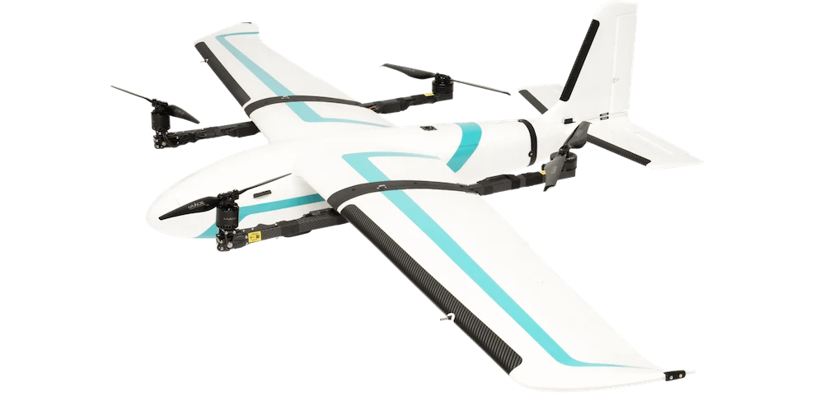
Optimal Control for
Powered-Lift UAV Landing
Lincoln Karavas
u7091679
Honours Project · October 2026
Supervisor: Matthew Hampsey
Examiner: Robert Mahony
Notes:
Hi my name is Lincoln and my project this year has been on optimal control for tilt rotor UAV Landings.

Slide 2
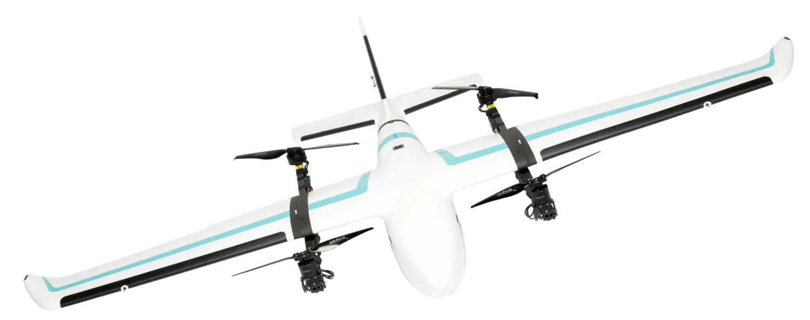
Powered-Lift UAVs
1
Medium-scale UAVs
2–7 m Wingspan
VTOL
Takes off and lands without a runway
2
Arace Griffin Pro
Fixed-wing flight
Efficiency and endurance of a plane
3
Used for delivery, agricultural spraying and search & rescue — mostly flown autonomously.
Notes:
Powered lift are generally medium scale drones in the 2-7m wing span range, that combine the efficiency and endurance of a fixed wing aircraft, without the infrastructure reequipments such as a runway that would typically be associated as they are vtol capable. Powered lift aircraft are becoming more and more popular in commercial setting like delivery programs such as wing or argriculcal spraying, search and rescue operation. With most of these applications requiring autonomous flight.
<make image viewable>
<explain VTOL>

Slide 3
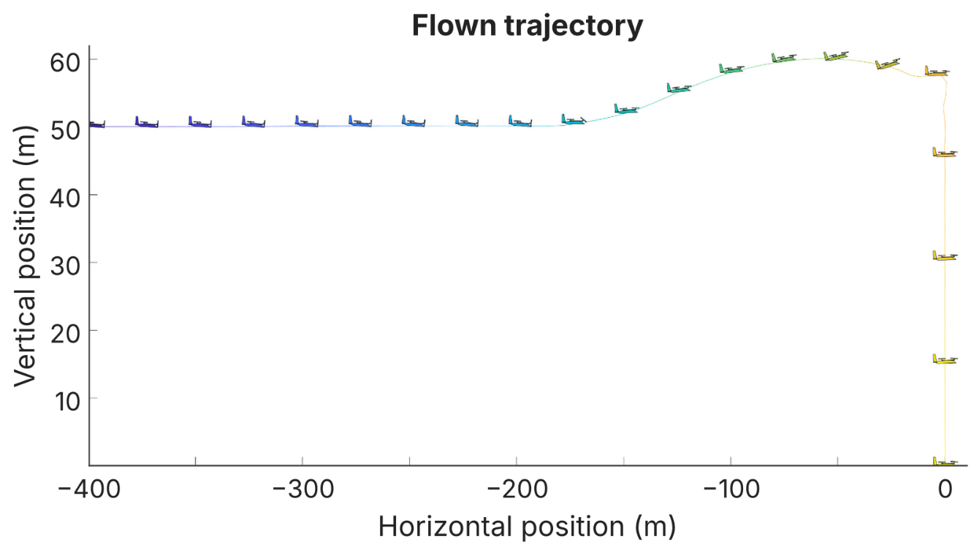
ArduPilot – Stock Tilt-Rotor Landing
90 s
of the 110 s landing is spent hovering down
≈ 3×
more power to hover than to fly as a fixed wing
Notes:
What you see here is the stock Ardupilot approach to landing a tilt rotor aircraft.
<needs to mention induced drag to slow down>
So it comes in at trim flight 50m above the ground until it decides it close enough to tilt the motors up and now flys as a multirotor exclusively, pitching up to slow down and then hovering down vertically to the landing point. This is inefficient as what isn’t shown in this diagram is the time spent in each phase but of the 110s trajectory shown 90s is hovering down in place, and hovering uses roughly 3x as much power as fixed wing flight. Which means the aircraft has to reduce payload capacity to carry around a bigger battery for the entire flight.
^ too much detail
<give more context on landing procedure and mode change>
<explain why hover takes more energy>

Slide 4
Project Goal
1
Efficient
Reduce power consumption during landing using a trajectory-optimisation approach
2
Accessible
Integrated into ArduPilot — no hardware changes required
Arace Griffin Pro
Notes:
therefore the goal of this project is to find a way to make the autonomous landings of these aircraft require less energy, but we also want this more efficient landing approach to be accessible to the public so the goal of integrating this into Ardupilot without requiring any hardware changes was added.

Slide 5
Workflow
1
2
3
4
Aircraft Dynamical Model
Longitudinal dynamics incl. post-stall aerodynamics and rotor forces
Trajectory Optimisation
Minimum-energy landing path within the aircraft's limits
Control
Time-varying LQR tracking the trajectory in an ArduPilot Lua script
Simulation
Tested in ArduPilot's SITL simulation environment
Notes:
**should I remove?**
To achieve this I used the this workflow.
First the aircraft has to be modelled so that the trajectory can be optimised. Following that a controller integrated into Ardupilot was made and simulated.

Slide 6
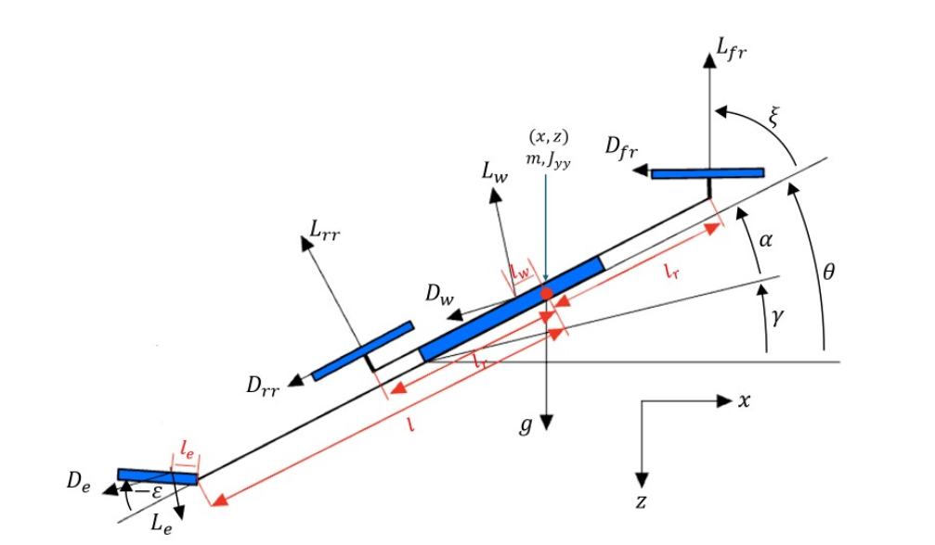
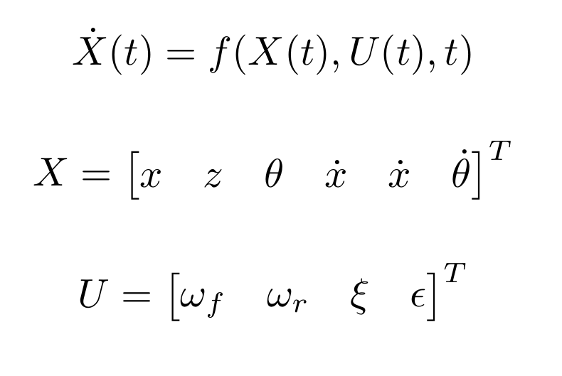
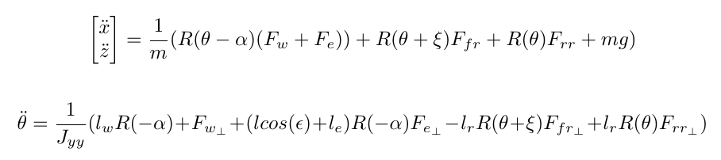
Aircraft Dynamical Model
Notes:
Modelling aircraft is not a new problem and there are many resources on how to do it but the overarching idea is that you have a function of the current state, position and attitude and the current inputs, motor throttles and aero surfaces and it tells you what the new state will be after some time step. For this project the model was limited to the longituninal dynamics of the aircraft as the lateral case is just stabilizing to trim flight.
<add + in equation>
<explain equation term by term>

Slide 7
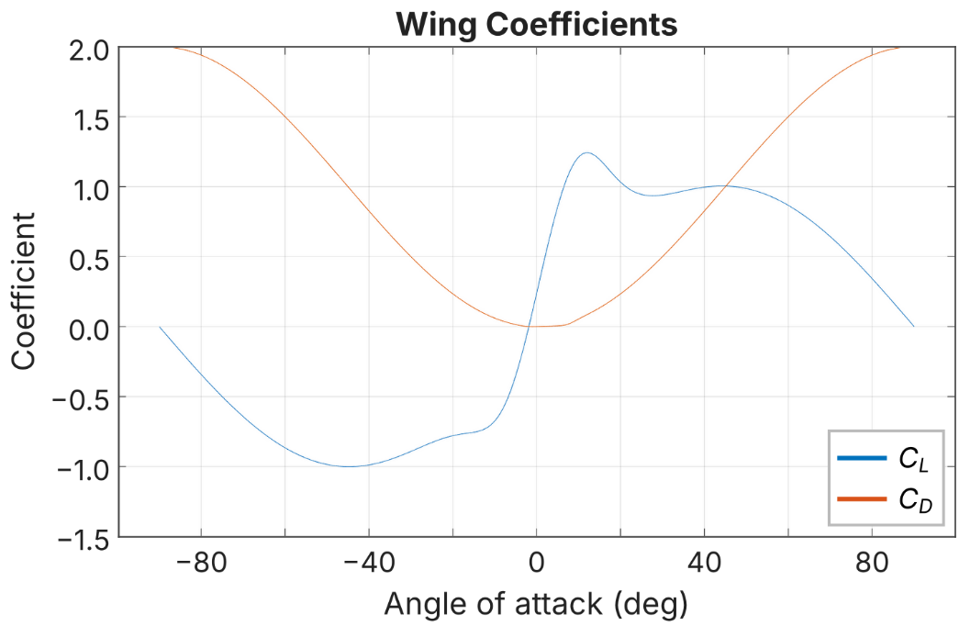
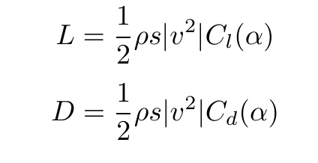
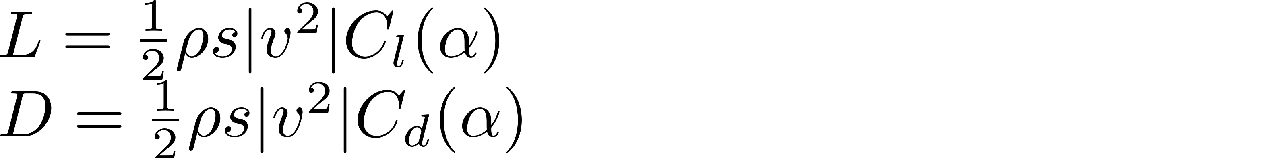
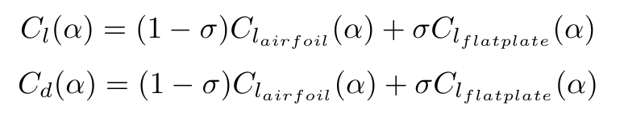


Aircraft Model – Aero Surfaces
Notes:
How this model differs to most aircraft models is how the aerodynamic surfaces are modeled. The general approach is to assume the aircraft won’t enter stall and therefore the lift and drag of the airfoils can be linearized.
However in this project stalling the aircraft could be a desired mode as the high drag associated could be used in slowing the aircraft, as such the coefficient of lift and drag transition from a standard linearized airfoil model at low angles of attack to acting as a flat plate post stall, allowing for stall behaviour to be modeled and therefore exploited in the trajectory optimisation.

Slide 8
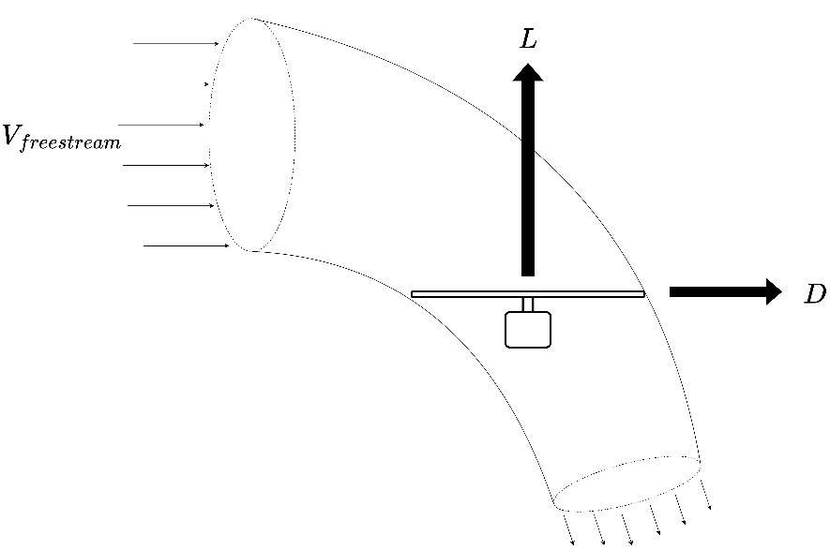
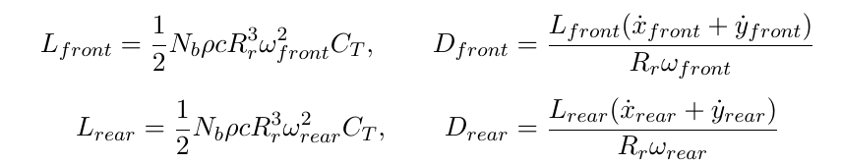
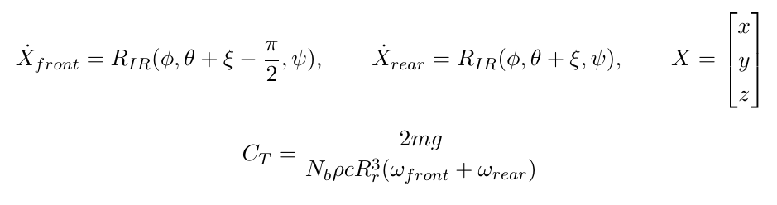
Aircraft Model – Rotors
Notes:
The other nonstandard part of the aircraft model is the rotor dynamics. Where the non axial forces of the rotor are also computed, as these can be used as an airbrake during the approach to slow the aircraft without requiring attitude changes. The rotor model was also linearized around the hover condition.
<rework to explain what it is more than how we calculate>

Slide 9
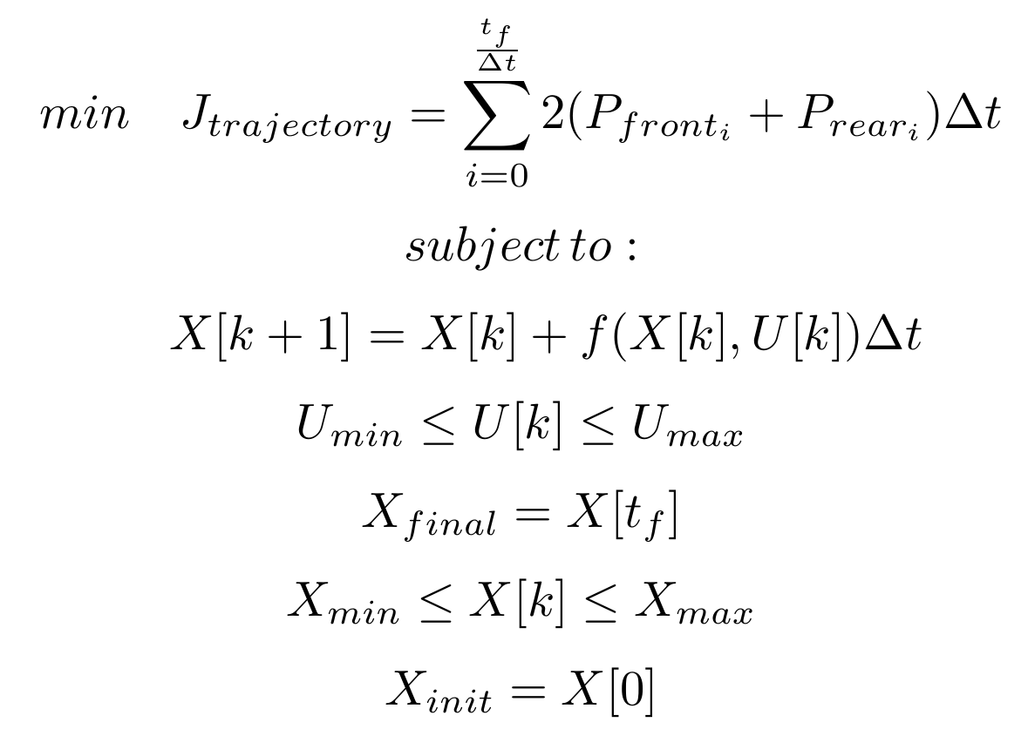
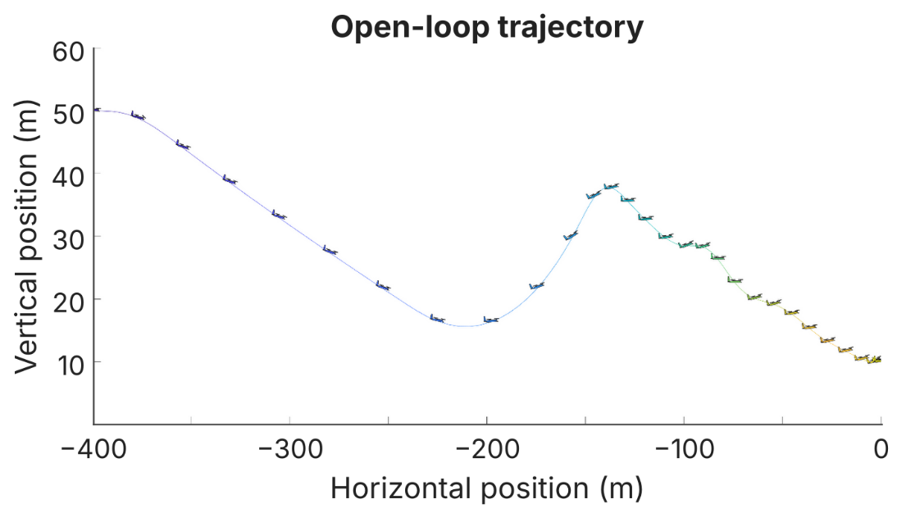
Trajectory Optimisation
Notes:
To optimize anything we need a cost function and a set of constraints. The cost function is integral of power throughout the trajectory as that is the goal of the project. The constraints are a bit more interesting, the first constraint is the dyanmics of the system, ensuring that the aircraft, can perform the maneuver, given its current state and inputs. The next two enforce the starting and ending conditions, and the last two restrict where the aircraft can go, the speed and attitude it can achieve as well as the limits of the motors and aerosurfaces.
<add euler int in con 1>
<add state and input constraints>
<shrink y axis>

Slide 10
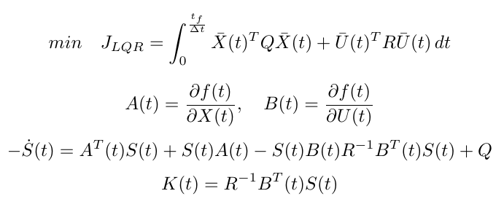
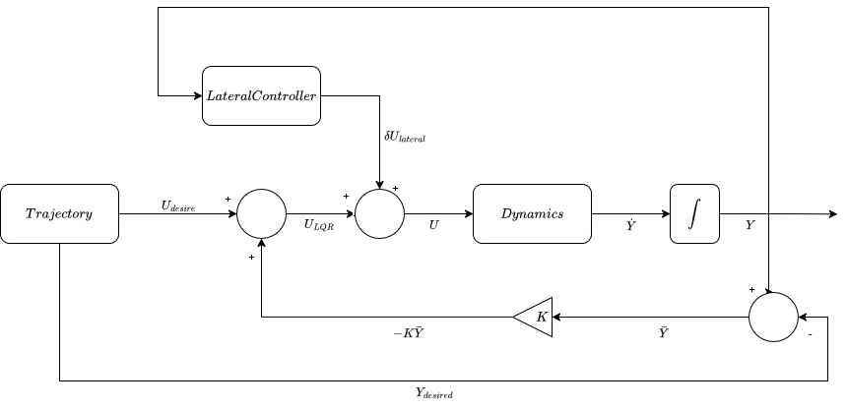
Control - LQR
Costs Solving Procedure, importing
Notes:
To optimize anything we need a cost function and a set of constraints. The cost function is integral of power throughout the trajectory as that is the goal of the project. The constraints are a bit more interesting, the first constraint is the dyanmics of the system, ensuring that the aircraft, can perform the maneuver, given its current state and inputs. The next two enforce the starting and ending conditions, and the last two restrict where the aircraft can go, the speed and attitude it can achieve as well as the limits of the motors and aerosurfaces.
<add euler int in con 1>
<add state and input constraints>
<shrink y axis>

Slide 11
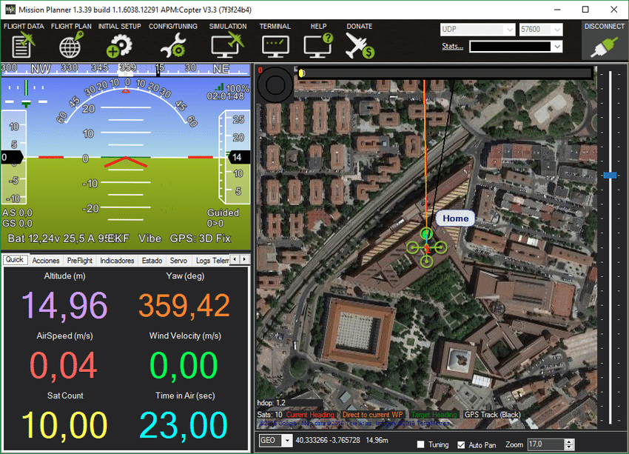
ArduPilot Implementation
Lua script
Runs on existing flight-controller hardware
1
Trajectory imported
Pre-computed optimal path loaded for the approach
2
Lateral control reimplemented
PD loops keep roll and yaw stable at low airspeed
3
Notes:
Rework for previous slide

Slide 12
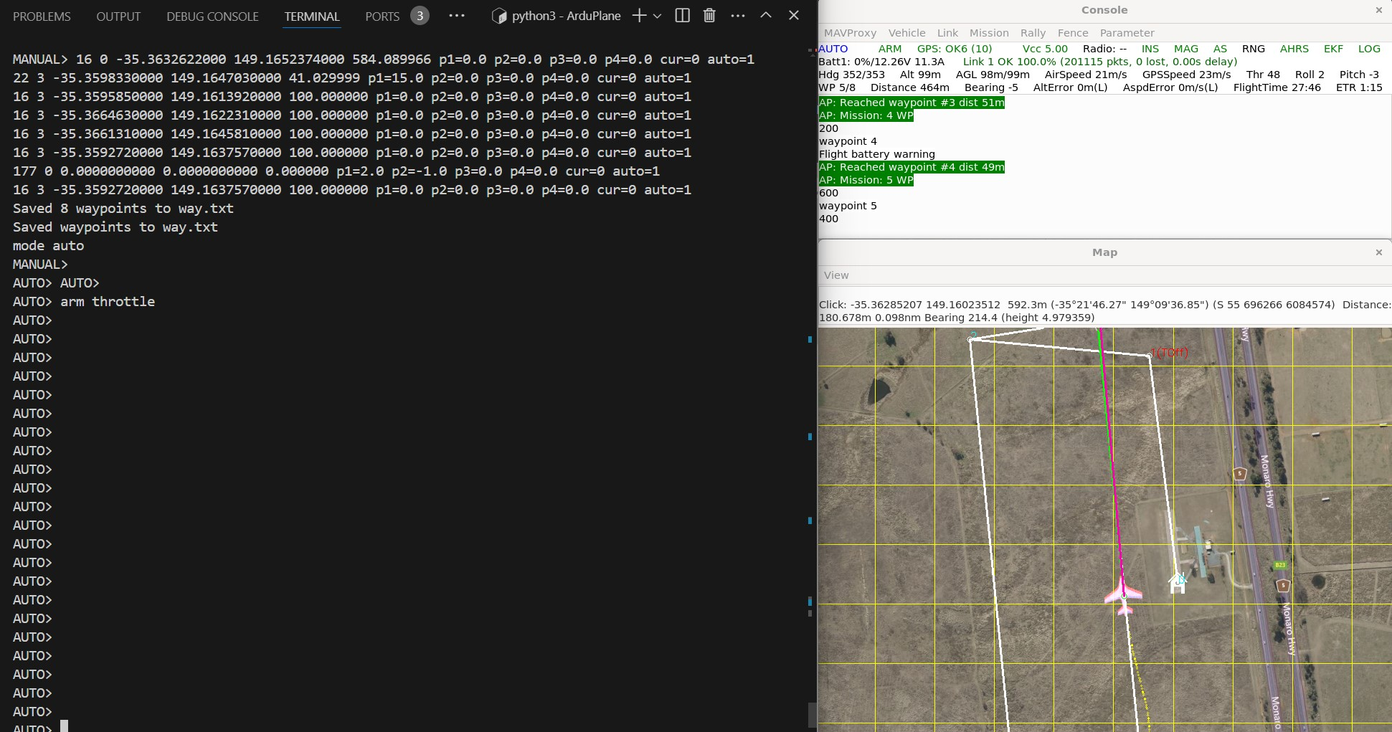
Simulation
1
ArduPilot Simulator
Software-in-the-loop (SITL): the real ArduPilot code and Lua controller fly a simulated aircraft
2
Revised Rotor Model
Simulator's rotor model updated to match the aircraft model used for optimisation
ArduPilot SITL flying a plane mission in MAVProxy. Image: ArduPilot Dev Team, CC BY-SA 3.0

Slide 13
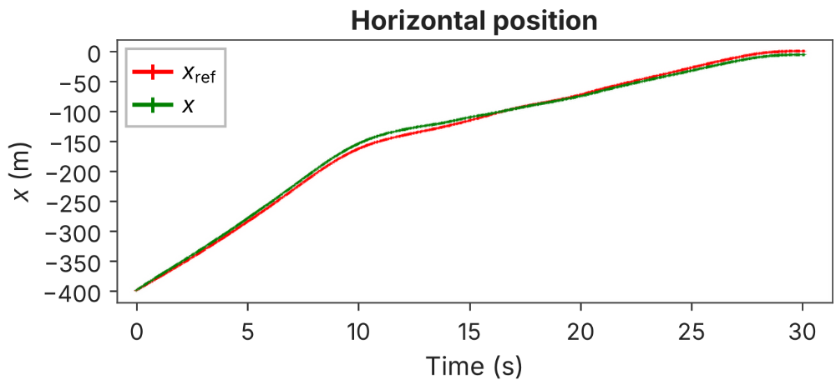
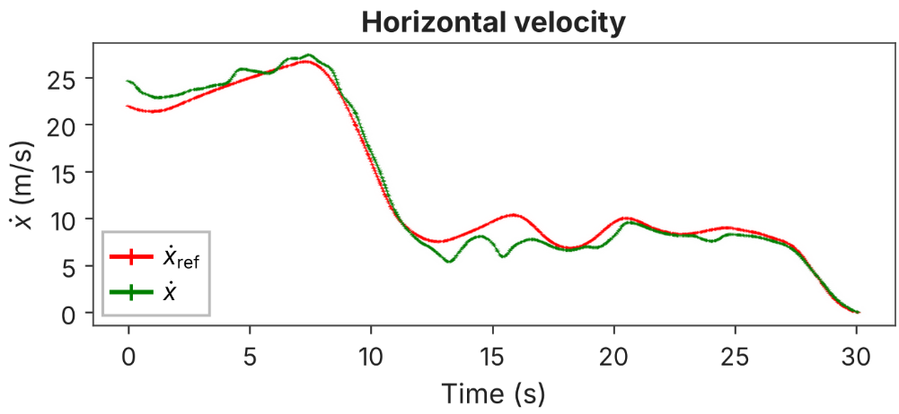
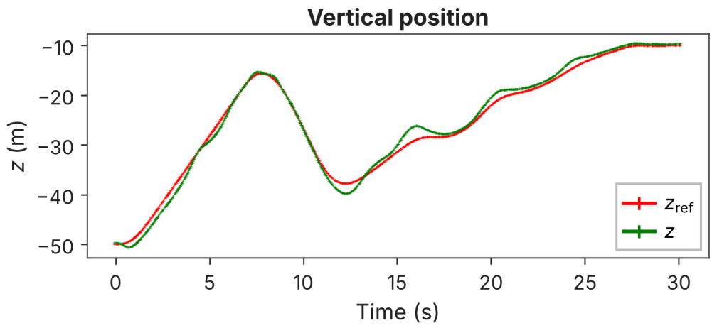
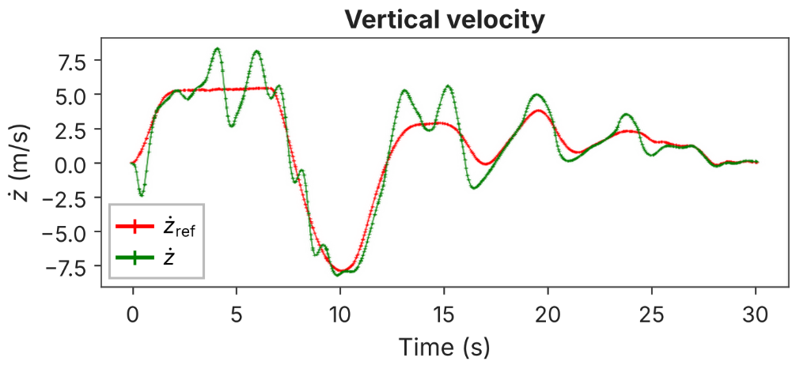
Control – Results
Notes:
Here are the results of the controller in Ardupilots simulatioin environment SITL.
The controller prioritises minimizing error in the position as flying off course can have dire consequences.

Slide 14
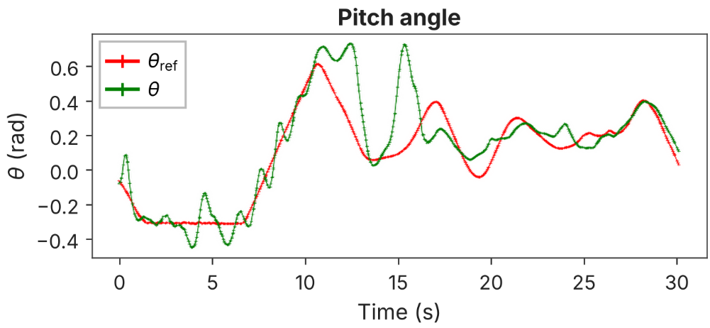
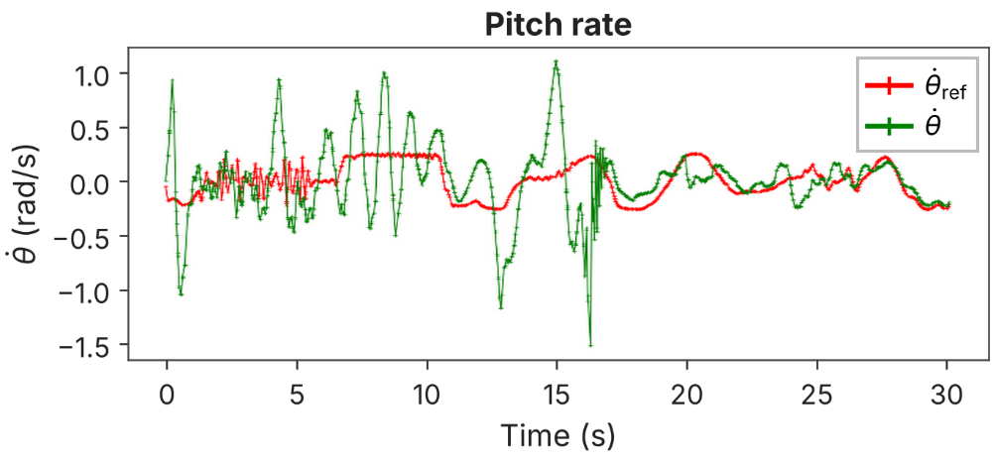
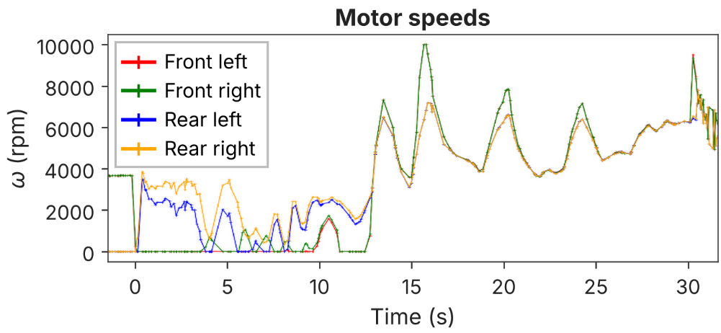
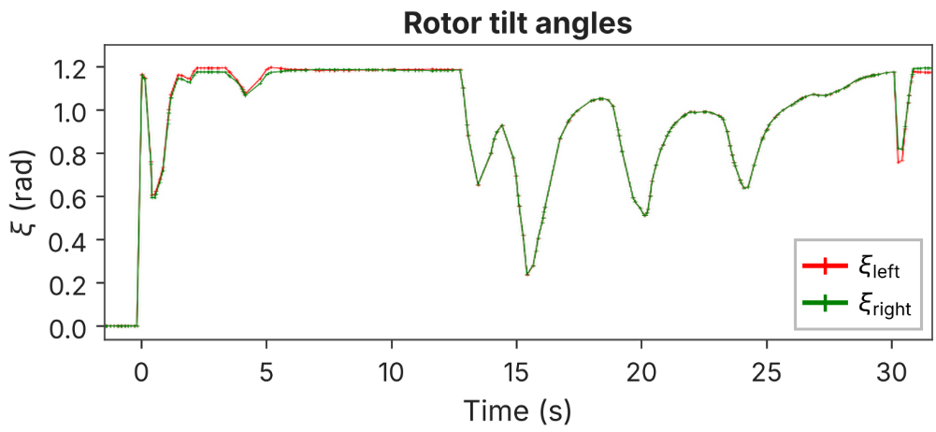
Control – Results (cont.)

Slide 15
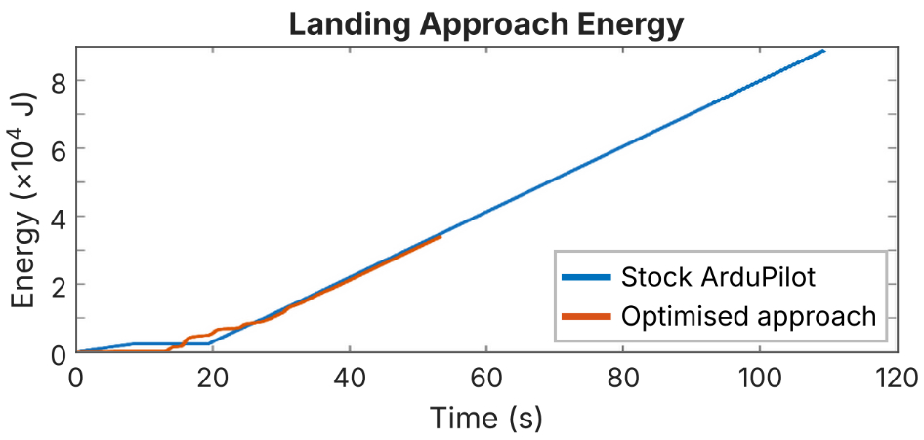
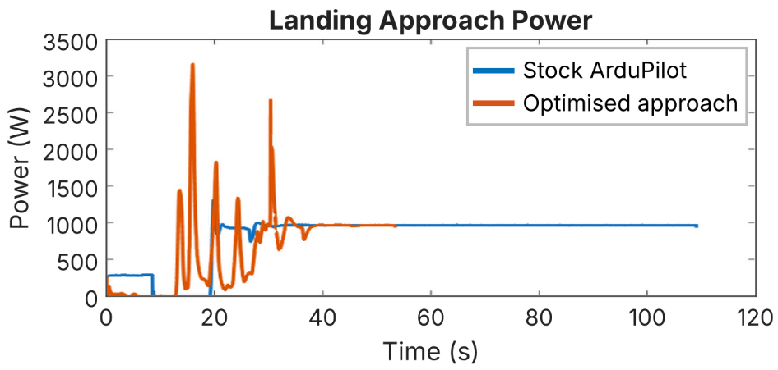
Efficiency Results
61%
less energy consumed than the stock ArduPilot landing
51%
shorter landing time
Notes:
As for the goal of the project a 61% reduction in energy consumption was achieved compared to the stock Ardupilot landing sequence. most of which is achieved in minimizing the time the aircraft hovers down. This could be extended further as a 10m altitude floor was part of the trajectory constraints, however this does come with more risk. The trajectory is also 72% quicker than the standard approach which could in commercial circumstances also be a critical value.

Slide 16
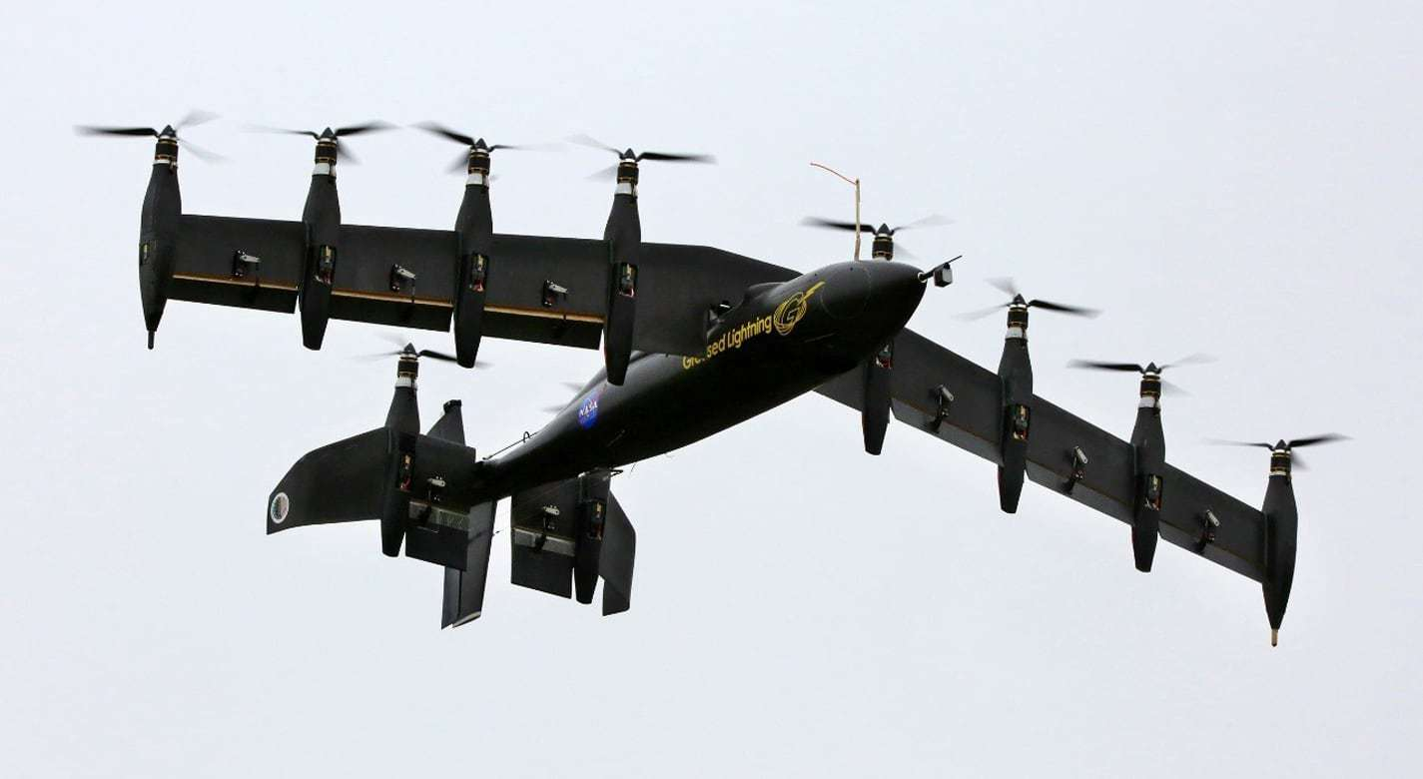
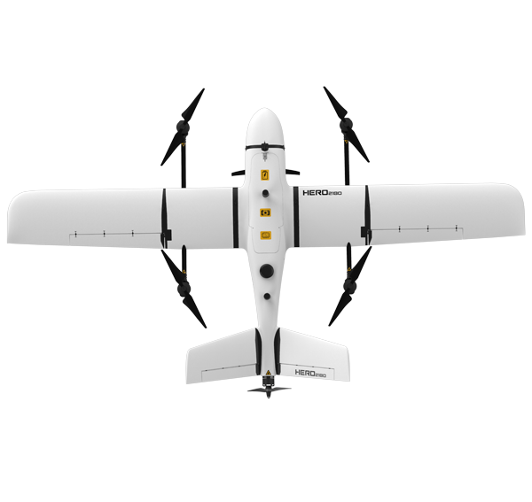
Future Work
1
Real-world flight testing
2
Extend the model to 3D
3
Support more airframes
4
Incorporate system identification

Slide 17
Thank you
Contact us
  Lincoln Karavas
  E u7091679@anu.edu.au

Slide 18
Appendix

Slide 19
Control – Longitudinal
Notes:
The controller for this project is implemented as a lua script that is called by Ardupilot during the flight and during the approach it overrides some of the control surfaces of the aircraft to track the proposed trajectory.
To control the longitundinal dynamics of the aircraft a time varying lqr was used, A because the goal of this project is energy efficiency and therefore some form of optimal controller should be used and B because lqr rather than something like MPC requires much less computational power it suits the goal of running on existing hardware better.

Slide 20
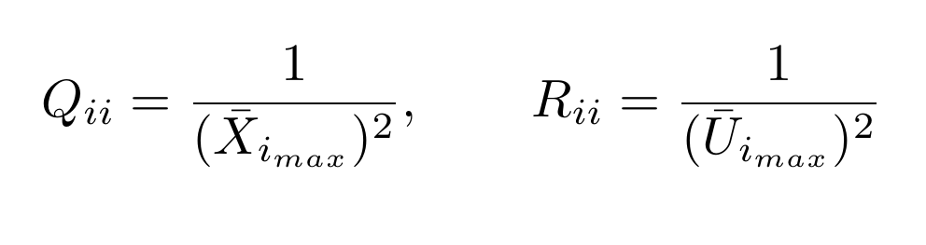
Control – Longitudinal Cost
Notes:
This is the cost function the LQR controller aims to solve where q is the cost on state error and R is how much it costs to use a control input to fix that error. Q and R were chosen based on these equations.

Slide 21
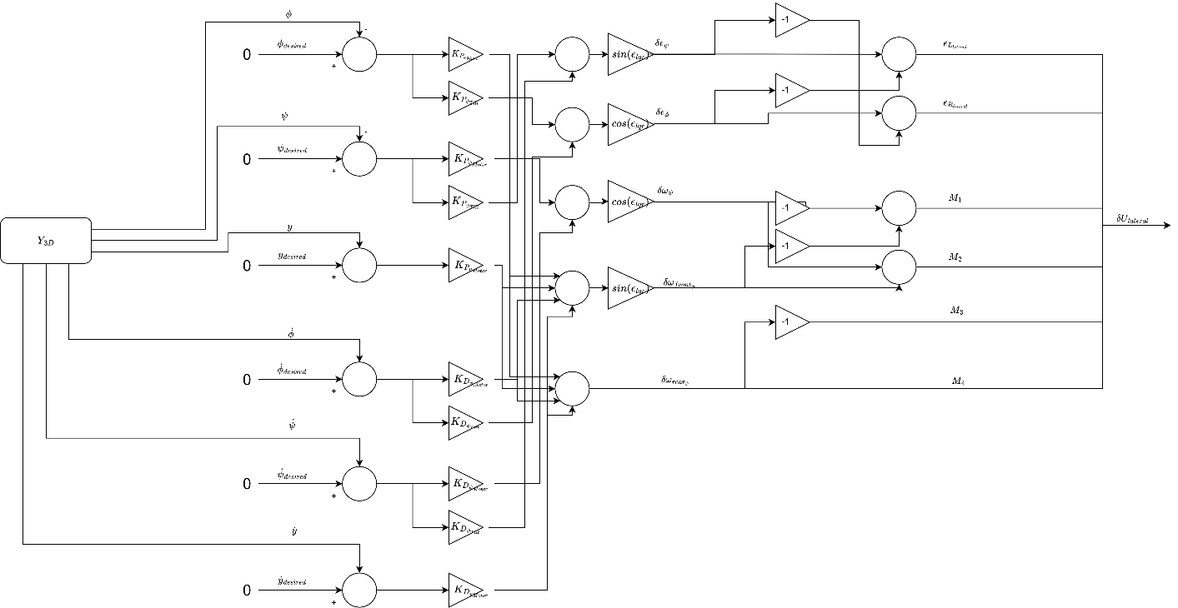
Control – Lateral
Notes:
The lateral dynamics are not of interest to this project and therefore ideally Ardupilot would remain in control of it however as the longitudinal control overrides the motor and tilt commands therefore once the aircraft slows and the rudder and aileron loose control authority, the lateral dynamics would be unstable. Therefore this series of PD controllers was added, it couldn’t be incorporated into the lqr as that requires a model of the dynamics to solve.

Slide 22
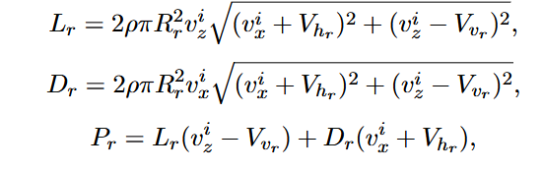

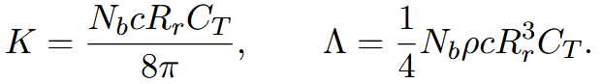
Rotor Power Model
Notes:
The lateral dynamics are not of interest to this project and therefore ideally Ardupilot would remain in control of it however as the longitudinal control overrides the motor and tilt commands therefore once the aircraft slows and the rudder and aileron loose control authority, the lateral dynamics would be unstable. Therefore this series of PD controllers was added, it couldn’t be incorporated into the lqr as that requires a model of the dynamics to solve.

